Slide 1
Introduction to Computer Graphics
Lecture 7:
Shading 1 (Illumination, Shading and Graphics Pipeline)
http://www.cs.ucsb.edu/~lingqi/teaching/games101.html

Slide 2
Last Lectures
Rasterization
-
-
-
Rasterizing one triangle Sampling theory Antialiasing

Slide 3
Today
Visibility / occlusion
- Z-buffering
Shading
-
-
Illumination & Shading Graphics Pipeline

Slide 4
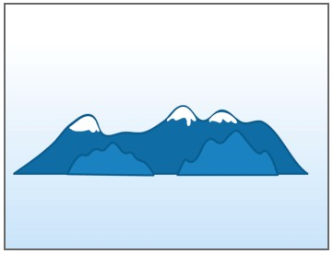
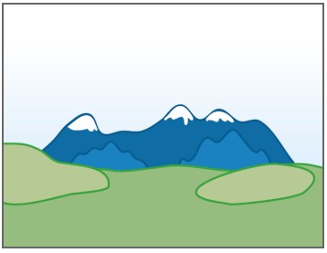
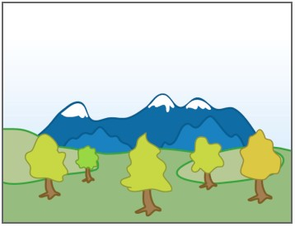
Painter’s Algorithm
Inspired by how painters paint
Paint from back to front, overwrite in the framebuffer
[Wikipedia]

Slide 5
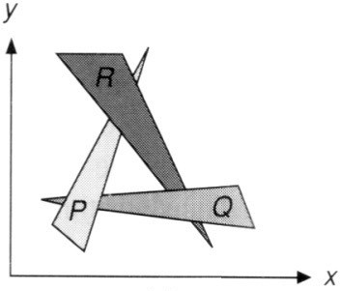
Painter’s Algorithm
Requires sorting in depth (O(n log n) for n triangles) Can have unresolvable depth order
[Foley et al.]

Slide 6
Z-Buffer
This is the algorithm that eventually won. Idea:
Store current min. z-value for each sample (pixel)
Needs an additional buffer for depth values
frame buffer stores color values
depth buffer (z-buffer) stores depth
IMPORTANT: For simplicity we suppose
z is always positive
(smaller z -> closer, larger z -> further)

Slide 7
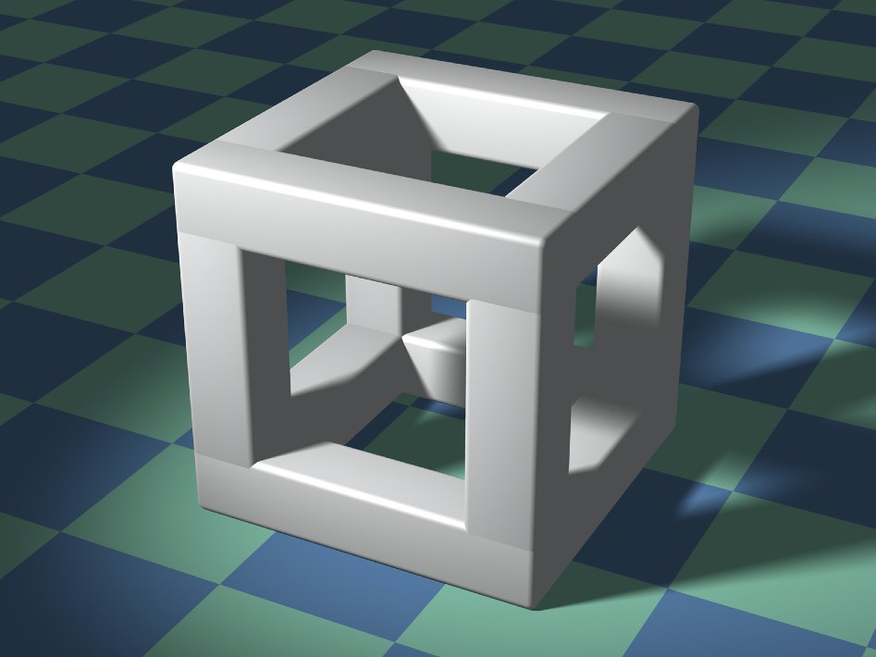
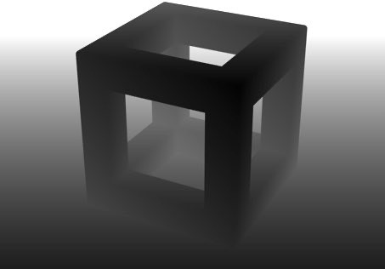
Z-Buffer Example
Image source: Dominic Alves, flickr.
Rendering
Depth / Z buffer

Slide 8
Z-Buffer Algorithm
Initialize depth buffer to ∞
During rasterization:
for (each triangle T)
for (each sample (x,y,z) in T) if (z < zbuffer[x,y])
framebuffer[x,y] = rgb; zbuffer[x,y] = z;
else
// closest sample so far
// update color
// update depth
; // do nothing, this sample is occluded

Slide 9
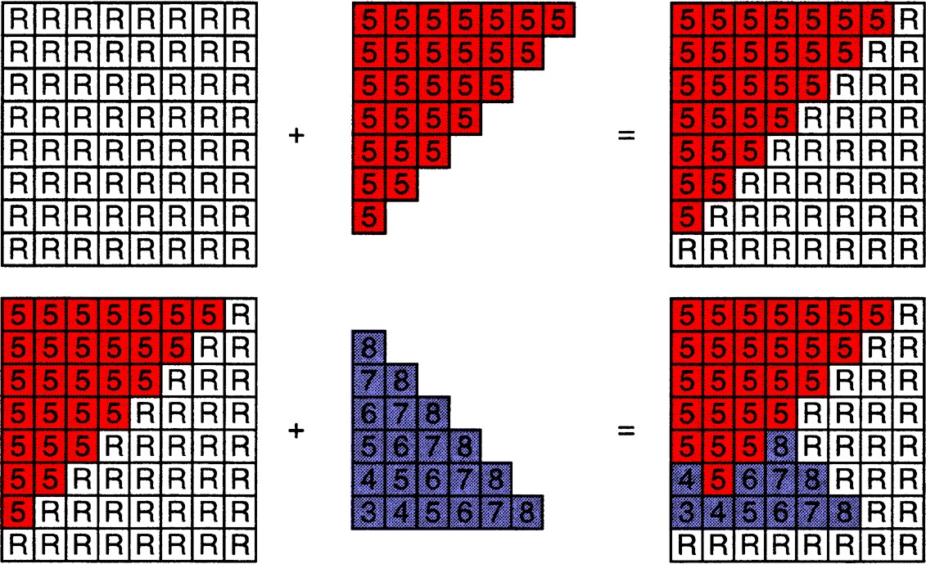
Z-Buffer Algorithm

Slide 10
Z-Buffer Complexity
Complexity
O(n) for n triangles (assuming constant coverage)
How is it possible to sort n triangles in linear time?
Drawing triangles in different orders? Most important visibility algorithm
Implemented in hardware for all GPUs

Slide 11
Questions?

Slide 12
Today
Visibility / occlusion
- Z-buffering
Shading
-
-
Illumination & Shading Graphics Pipeline

Slide 13
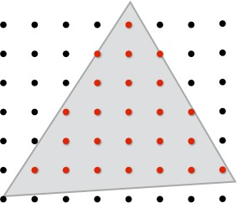
What We’ve Covered So Far
y
y
z
z
x
x
Position objects and the camera in the world
Compute position of objects relative to the camera
(w, h)
(0, 0)
Project objects onto the screen
Sample triangle coverage

Slide 14
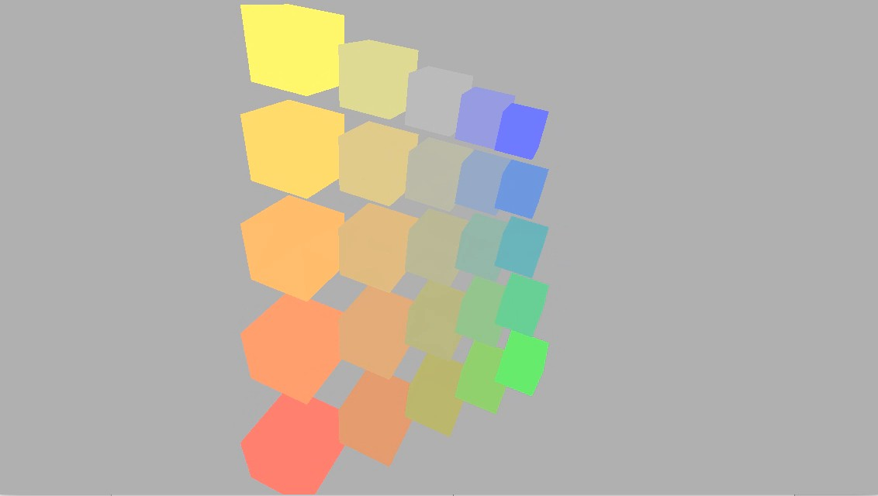
Rotating Cubes (Now You Can Do)

Slide 15
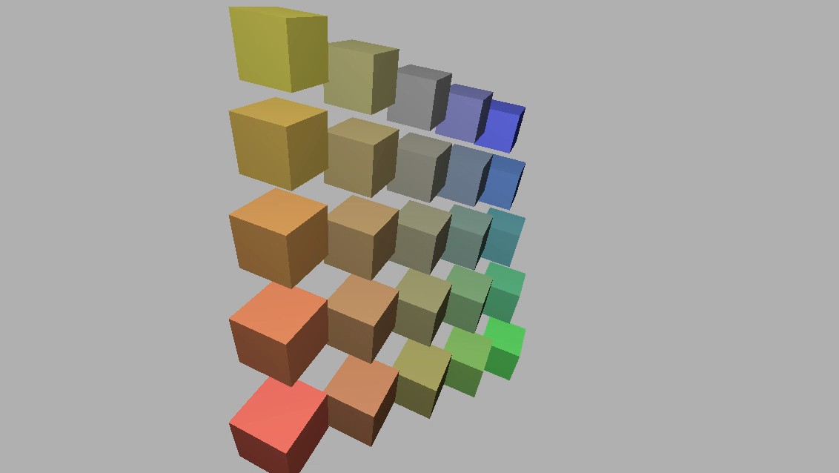
Rotating Cubes (Expected)

Slide 16

What Else Are We Missing?
Credit: Bertrand Benoit. “Sweet Feast,” 2009. [Blender /VRay]

Slide 17
Shading

Slide 18

Shading: Definition
In Merriam-Webster Dictionary
shad·ing, [ˈʃeɪdɪŋ], noun
The darkening or coloring of an illustration or diagram with parallel lines or a block of color.
In this course
The process of applying a material to an object.

Slide 19
A Simple Shading Model (Blinn-Phong Reflectance Model)

Slide 20

Perceptual Observations
Specular highlights
Diffuse reflection Ambient lighting
Photo credit: Jessica Andrews, flickr

Slide 21



Shading is Local
Compute light reflected toward camera at a specific shading point
Inputs:
Viewer direction, v
Surface normal, n
Light direction, l
(for each of many lights)
Surface parameters (color, shininess, …)
l
n
v
shading point

Slide 22
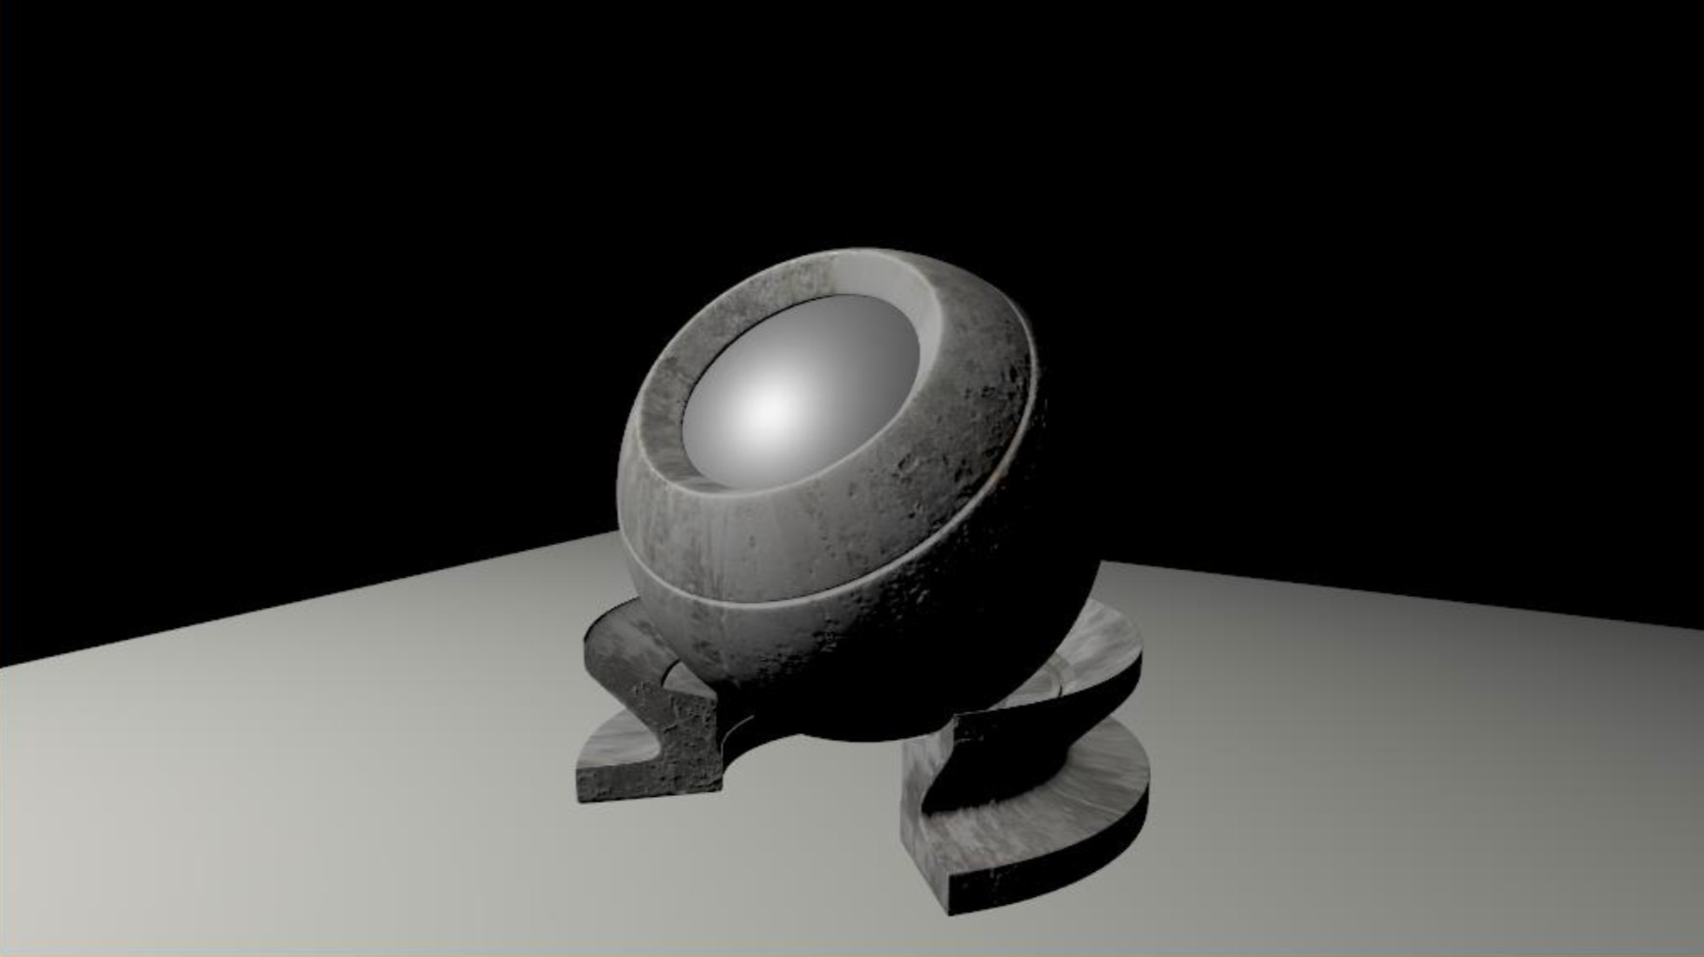
Shading is Local
No shadows will be generated! (shading ≠ shadow)

Slide 23
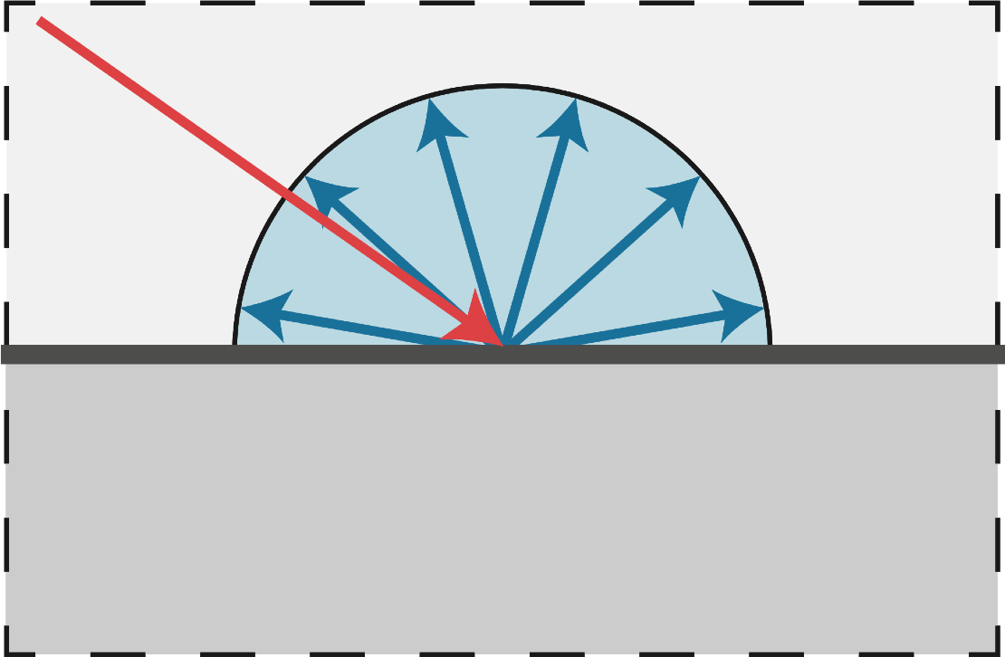
Diffuse Reflection
Light is scattered uniformly in all directions
- Surface color is the same for all viewing directions

Slide 24

Diffuse Reflection
But how much light (energy) is received?
- Lambert’s cosine law
l
n
8
Top face of cube receives a certain amount of light
Top face of 60º rotated cube
intercepts half the light
In general, light per unit area is proportional to cos θ = l • n

Slide 25

Light Falloff
intensity here: I/r²
intensity here: I

Slide 26
Lambertian (Diffuse) Shading
Shading independent of view direction
energy arrived
at the shading point
l
n
L_{d} = k_{d} (I/r²) max(0, n · l)
ε
v
diffuse coefficient (color)
energy received by the shading point
diffusely reflected light

Slide 27
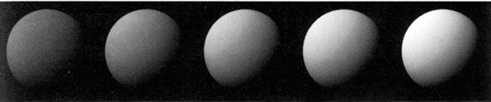
Lambertian (Diffuse) Shading
Produces diffuse appearance
[Foley et al.]
k_{d}

Slide 28
Thank you!
(And thank Prof. Ravi Ramamoorthi, Prof. Lingqi Yan and Prof. Ren Ng for many of the slides!)

